Slide 1
Resource-Aware Collaborative Cloud IDE using Intelligent Optimization and Container Orchestration
Under the guidance of Prof. Gauri Doke
Department of Computer Engineering, Army Institute of Technology, SPPU, Pune
BE Computer 2026-27

Slide 2
Problem and Research Gaps
Problem
Gaps in existing work
Latency during real-time code synchronization
Conflict handling in multi-user editing
Inefficient resource allocation and wastage
No adaptive scaling for bursty workloads
Collaboration and resource optimization not integrated
Limited intelligent scheduling in cloud IDEs
Static resource allocation
No energy-aware execution model
Limited container lifecycle automation

Slide 3
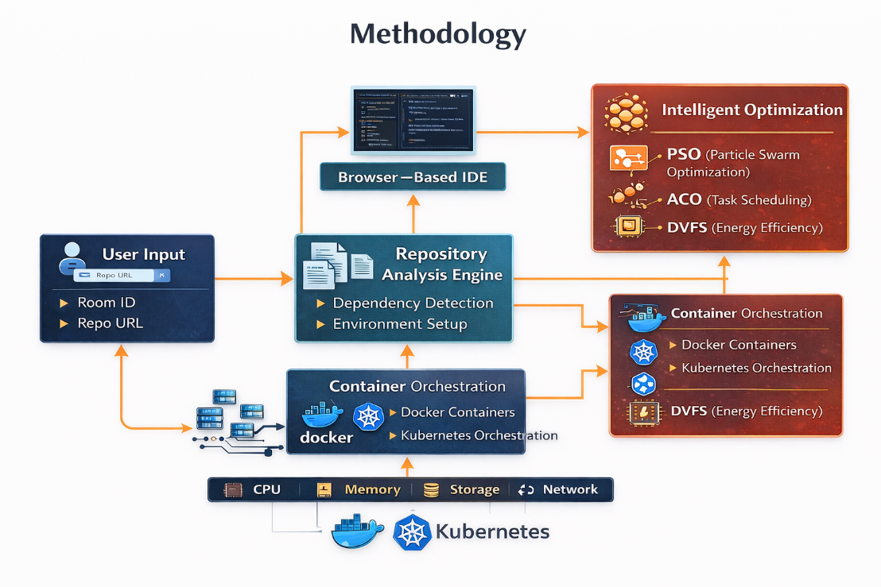
Proposed System Architecture
User joins with Room ID and repository URL
Repository analysis detects dependencies
Optimization engine decides allocation and placement
Docker isolates each workspace; Kubernetes orchestrates
Monitoring feeds back into ARAA and ARKLM

Slide 4
Intelligent Optimization Engine
PSO
ACO
DVFS
Finds the best CPU and memory allocation for active workspaces
Places workspaces across nodes using pheromone-guided scheduling
Adjusts CPU voltage and frequency to match workload
Combined result: balanced load distribution and lower energy consumption.

Slide 5
Adaptive Scaling (ARAA) and Lifecycle (ARKLM)
ARAA: fast, per-workspace scaling
ARKLM: slow, strategic lifecycle
Monitors utilization via Kubernetes Metrics API
Scales up when utilization is above target
Scales down when below target
Uses hysteresis and cooldown to avoid oscillation
Detects idle workspaces
Saves workspace state, then scales pods to zero
Restores the workspace when the user returns
Consolidates workloads onto fewer nodes

Slide 6
Evaluation Plan
Baselines: static allocation, default Kubernetes HPA, proposed system
Workload: 5 to 50 concurrent users with scripted typing, build, run and idle phases
Metrics: CPU, memory, idle container hours, energy, editing latency (mean and 95th percentile), scale-up time
Each experiment repeated several times; mean and standard deviation reported
Results: to be added after experiments

Slide 7
Conclusion and Future Work
Integrates real-time collaboration with adaptive resource management
Docker and Kubernetes give isolation, scalability and load balancing
PSO, ACO and DVFS with ARAA and ARKLM target lower waste and energy use
Future work: ML-based workload forecasting, hybrid PSO-ACO, edge and multi-cluster deployment
Thank you

